Slide 1
Capstone Engagement
Assessment, Analysis, and Hardening of a Vulnerable System

Slide 2
Red Team And Blue Team Exercise
Objective Summary
Weak passwords discovered through brute force login
Password using weak encryption easily cracked
Password hashes discovered in easily accessible folders
Hidden folders easily discovered and unprotected
Red Team was able to exploit vulnerabilities and capture the flag
Blue team detected the attack through analysis. But not prevent it
If this was a real successful attack, company’s Data, reputation, and revenue will be lost.

Slide 3
Table of Contents
This document contains the following sections:
01
Network Topology
02
Red Team: Security Assessment
03
Blue Team: Log Analysis and Attack Characterization
Hardening: Proposed Alarms and Mitigation Strategies
04

Slide 4
Network Topology
4

Slide 5
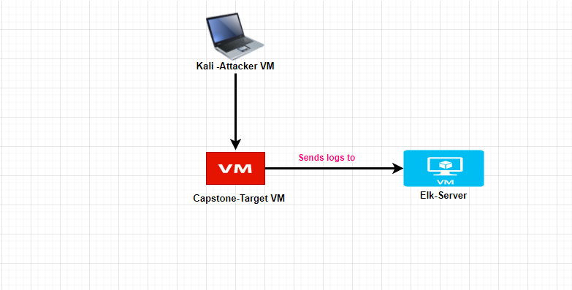
Network Topology
[Insert Here]
Use draw.io to create a diagram of the network.
Add your diagram to this slide and fill out the data in the sidebar.
Network
Address Range:192.168.1.0/24
Netmask:255.255.255.0
Gateway:192.168.1.1
Machines
IPv4: 192.168.1.90
OS: Linux
Hostname:Kali
IPv4:192.168.1.100
OS:Linux
Hostname:Elk
IPv4:192.168.1.105
OS:Linux
Hostname:Capstone

Slide 6

Red Team
Security Assessment
6

Slide 7
Recon: Describing the Target
Nmap identified the following hosts on the network:
Hostname | IP Address | Role on Network
Kali | 192.168.1.90 | Attacker machine Penetration testing system
Capstone | 192.168.1.105 | Victim machine Transfer log data to Elk
Elk server | 192.168.1.100 | Monitor all the logs through Kibana (Packetbeat, metricbeat and Filebeat)

Slide 8
Vulnerability Assessment
The assessment uncovered the following critical vulnerabilities in the target:
Vulnerability | Description | Impact
Directory Listing Enabled on Apache Web Server port 80 is open. | Able to use browser to read full contents of directories on Capstone Apache web server. | Files revealed user Ashton is the administrator for the directory: /company_folders/secret_folder/
Weak password | Password was weak ( less than 8 characters, no special characters) | Brute force provided access to: /secret_folder/ Password hash for Ryan dav://192.168.1.105/webdav/
Sensitive Data | Data discovered in non-secure location | Attacker will be able to continue to escalate privileges
PHP reverse shell back door | We were able to create a reverse shell on web server | Remote backdoor shell access to Capstone Apache web server

Slide 9
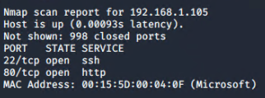
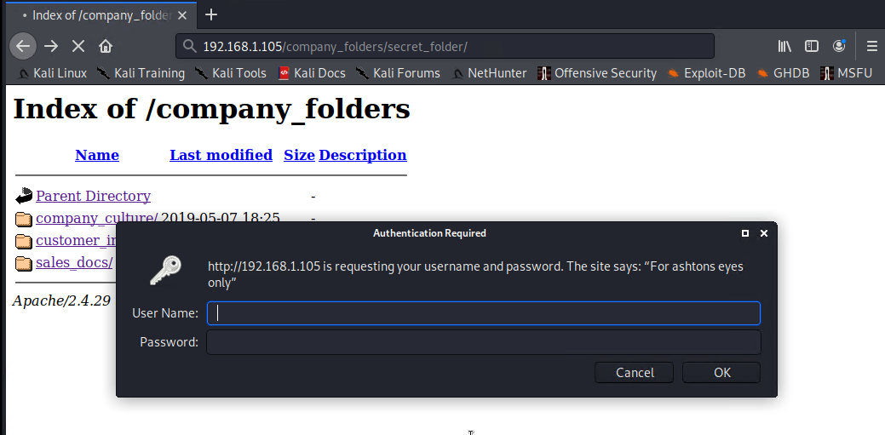
Exploitation: [Directory Listing Enabled on Apache]
01
02
03
.
Tools & Processes
Nmap Network scan
Browser to explore
Navigating 192.168.1.105/ with any web browser
Achievements
Granted access to company secret file and folders through HTTP
This directory is password protected but easy to brute-force.
Found Ashton is the admin for /company_folders/secret_folder/

Slide 10
Exploitation: [Weak Password,unauthorized file Upload]
01
02
03
Tools & Processes
By using wordlist to get the password of the user (Ashton)
Executing Hydra brute force dictionary attack bash tool to get password for Ashton’s account
- Password for Ashton was found in ‘rockyou’ dictionary
Access to the /secret_folder/ was achieved.
Access info for /webdav/ system was found
-
Hash for Ryan’s password was found and cracked allowing access to webdav
hydra -l ashton -P /usr/share/wordlists/rockyou.txt -s 80 -f -vV 192.168.1.105 http-get /company_folders/secret_folder/

Slide 11
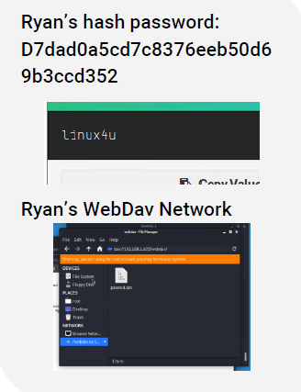
Exploitation: [Sensitive Data]
01
02
03
Tools & Processes
After gaining access to the Secret Folder we discovered a document telling us how to gain access to the Corporate Server.
Achievements
I was able to gain access to the CEO’s WebDav account

Slide 12
Exploitation: [Reverse shell/php.shell Backdoor]
01
02
03
Tools & Processes
- Created and uploaded msfvenom payload: php/meterpreter/reverse_tcp
Established remote listener.
Executed reverse shell backdoor on Capstone Apache server.
Achievements
- Opened a remote backdoor shell to the Capstone Apache server and gained access to root directory on the Capstone 192.168.1.105 server.
Aftermath
Achieving a shell on the target allows us to view all files and capture the flag
cat flag.txt : b1ng0w@5h1sn@m0

Slide 13

Blue Team
Log Analysis and Attack Characterization
13

Slide 14

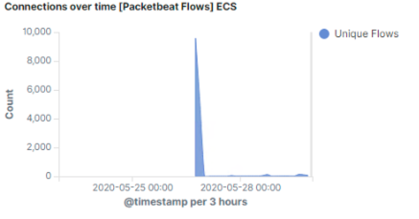
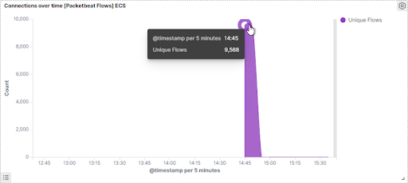
Analysis: Identifying the Port Scan
.
The port scan was peformed by 192.168.1.90 occurred at 2:45 Pm
9,568 Packets, from IP Address: 192.168.1.90
Multiple ports requested at the same time are proof of the port scan.
[Insert Here]
Include a screenshot of Kibana logs depicting the port scan.

Slide 15
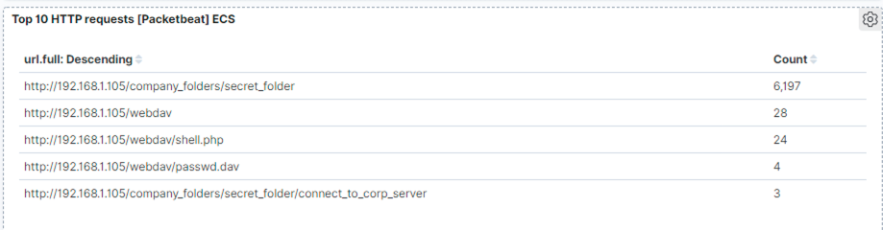
Analysis: Finding the Request for the Hidden Directory
The request for the hidden directory occurred at 2:45PM
6,197 times were made. Mostly during the brute force attack
The ‘’ connect_to_corp_server” file was requested. Which contains instruction to connect to Webdav
[Insert Here]
Include a screenshot of Kibana logs depicting the request for the hidden directory.

Slide 16
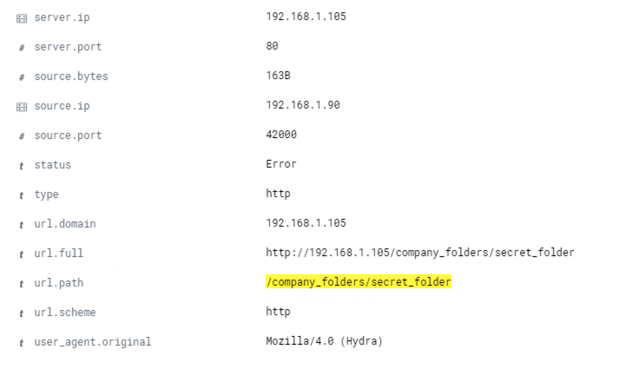
Analysis: Uncovering the Brute Force Attack
.
10,543 requests were made in the attack.
6,693 requests were made from the attacker’s IP 192.168.1.90 before he discovered the password
[Insert Here]
Include a screenshot of Kibana logs depicting the brute force attack.

Slide 17
Analysis: Finding the WebDAV Connection
.
28 requests were made to this directory /webdav.
Backdoor payload shell.php was uploaded on June 18, 2020 at 1:34:34
[Insert Here]
Add a screenshot of Kibana logs depicting the WebDAV connection.

Slide 18
Blue Team
Proposed Alarms and Mitigation Strategies
18

Slide 19
Mitigation: Blocking the Port Scan
What kind of alarm can be set to detect future port scans?
- Alert email and log when > 3 none port 403 or port 80 scans detected at the same timestamp from the same IP occur.
What threshold would you set to activate this alarm?
- Alarms should fire if a given IP address sends more than 10 requests per second for more than 5 seconds
What configurations can be set on the host to mitigate port scans?
-The local firewall can be used to throttle incoming connections
-ICMP traffic can be filtered
An IP whitelist can be enabled
IPtables/Firewall port blocking and scan delay are effective port scan mitigation techniques

Slide 20
Mitigation: Finding the Request for the Hidden Directory
What kind of alarm can be set to detect future unauthorized access?
Whitelist authorized IP addresses
Trip alarm if an IP not on the whitelist attempts to connect. IP other than 192.168.1.105
What threshold would you set to activate this alarm?
This is a binary alarm: If the incoming IP is not whitelisted, it fires. Otherwise, it does not.
What configuration can be set on the host to block unwanted access?
Access to the sensitive file can be locally restricted to a specific user.
This way, someone who gets a shell as, e.g., www-data will not be able to read it.
In addition, the file should be encrypted at rest.

Slide 21
Mitigation: Preventing Brute Force Attacks
What kind of alarm can be set to detect future brute force attacks?
-Create alert to detect error codes or failure attempts.ex: Error(401)
What threshold would you set to activate this alarm?
More than 100 requests per second for 5 seconds should trigger the alarm
What configuration can be set on the host to block brute force attacks?
- Configuring fail2ban or a similar utility would mitigate brute force attacks
Account lockout policy
-Ask users to answer a security response upon multiple failed logins.

Slide 22
Mitigation: Detecting the WebDAV Connection
What kind of alarm can be set to detect future access to this directory?
Monitor access to webdav with Filebeat
Fire an alarm on any read performed on files within webdav
What threshold would you set to activate this alarm?
Simply fire the alarm whenever someone accesses the webdav directory.
Ideally, whitelist valid IP addresses
What configuration can be set on the host to control access?
Administrators must install and configure Filebeat on the host.
Removing this non-essential (extremely dangerous) directory would prevent any unauthorized access to the Corporate Server.

Slide 23
Mitigation: Identifying Reverse Shell Uploads
What kind of alarm can be set to detect future file uploads?
- Alarms should fire upon receipt of any POST request containing form or file data of a disallowed file type .php
What threshold would you set to activate this alarm?
- The alarm should fire whenever users upload a forbidden file.
What configuration can be set on the host to block file uploads?
Write permissions can be restricted on the host.
Uploads can be isolated into a dedicated storage partition.
Filebeat should be enabled and configured.

